Slide 1


Steven Petruzzelli
July 02 2025

Slide 2

Outline
Executive Summary
Introduction
Methodology
Results
Conclusion
Appendix

Slide 3
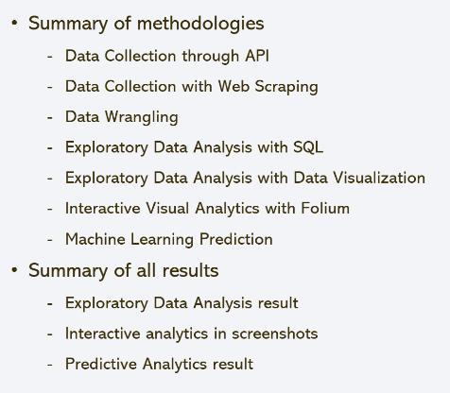
Executive Summary

Slide 4
Introduction
Project background and context
Spacex falcon 9 launches
Problems you want to find answers
If the rockets land successfully what were determining factors.
Successful landing and success rate
Safe operating conditions that need to be in place

Slide 5

Section 1

Slide 6
Methodology
Executive Summary
Data collection methodology:
Data was collected and processed for analysis using webscraping and api
Perform data wrangling
One-hot encoding was applied.
Perform exploratory data analysis (EDA) using visualization and SQL
Perform interactive visual analytics using Folium and Plotly Dash
Perform predictive analysis using classification models
Procedures followed while maintaining accuracy.

Slide 7
Data Collection
Data was collecting using the methodologies in data science.
Data prepared -> data reviewed -> data processed -> data analyzed

Slide 8
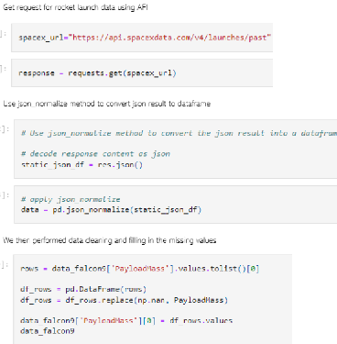
Data Collection – SpaceX API
Present your data collection with SpaceX REST calls using key phrases and flowcharts

Slide 9
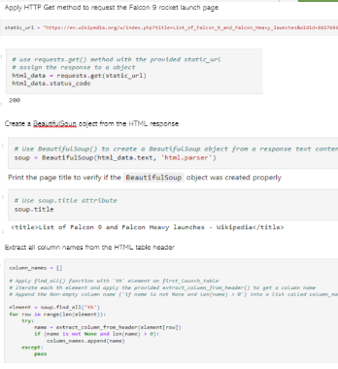
Data Collection - Scraping
Webscraping falcon 9 launches with beautiful soup
Parsed table and converted with pandas

Slide 10
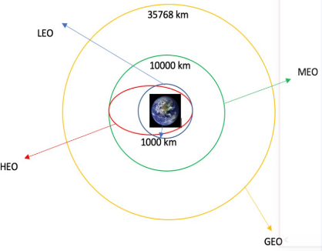
Data Wrangling
Exploratory analysis
number of launches and occurences were calculated.

Slide 11
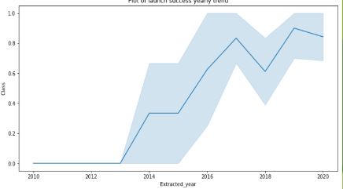
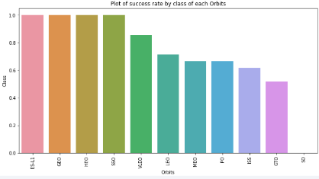
EDA with Data Visualization
We explored relationships between flight number, launch site, payload, etc.

Slide 12
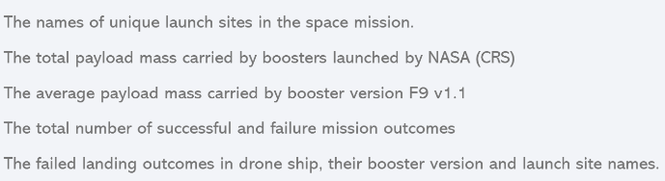
EDA with SQL
https://github.com/cert1fied/spacex

Slide 13
Build an Interactive Map with Folium
Marked all launch site
Calculated failure
Labled marker clusters

Slide 14
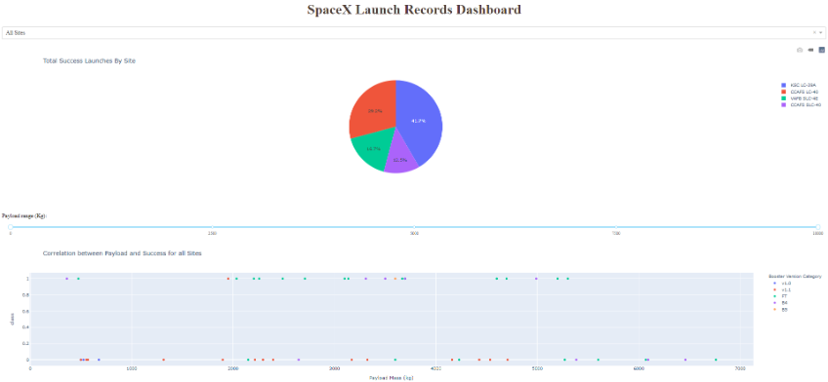
Build a Dashboard with Plotly Dash
we built an interactive dash with plotly dash
plot charts
Scatter graphs

Slide 15
Predictive Analysis (Classification)
we loaded data using numpy and pandas. also transofmred data
we built different machine learning models using gridsearchcv for hyperparameters.
we found best performing classification model
https://github.com/cert1fied/spacex/blob/main/SpaceX_Machine%20Learning%20Prediction_Part_5.ipynb

Slide 16
Results
Exploratory data analysis results
Interactive analytics demo in screenshots
Predictive analysis results

Slide 17

Section 2

Slide 18
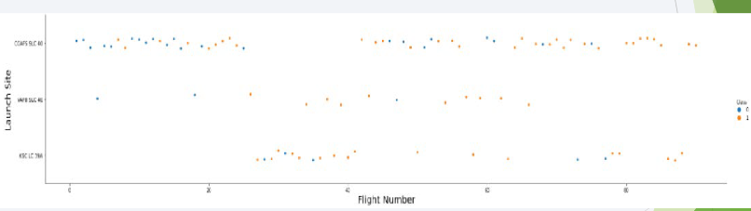
Flight Number vs. Launch Site
from the plot we found that the larger the flight amount at a launch site the greater success rate.

Slide 19
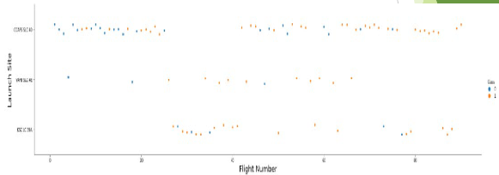
Payload vs. Launch Site
the greater the payload mass for launch site CCAFS SLC 40 the higher the success rate for the rocket.

Slide 20

Success Rate vs. Orbit Type
from the plot we see es-l1, geo, heo, sso, vleo had most success.

Slide 21
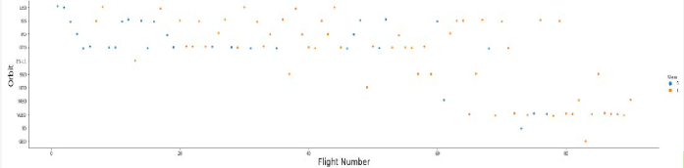
Flight Number vs. Orbit Type
the plot below shows flight number vs. orbit type. we observe in LEO orbit success is ralted to number of flights whereas in gto orbit there is no relationship between flight number and orbit

Slide 22
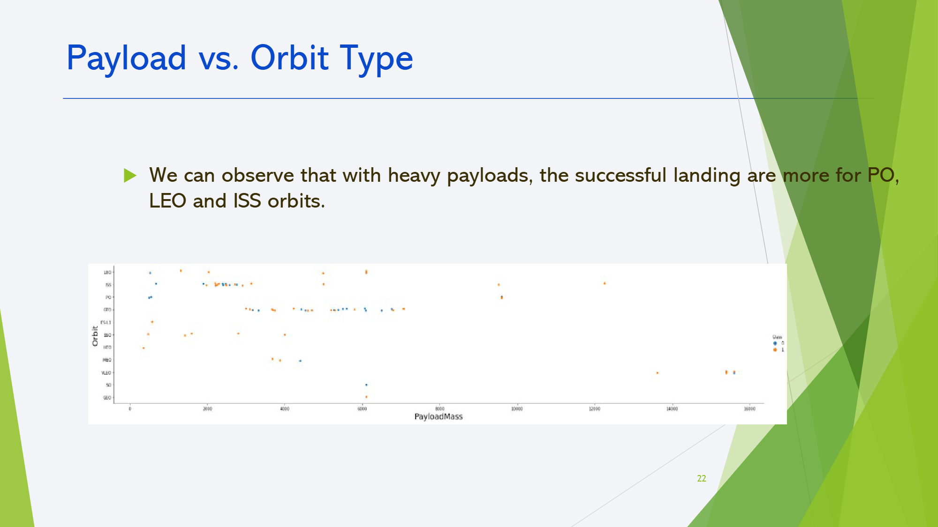
Payload vs. Orbit Type
Show a scatter point of payload vs. orbit type

Slide 23
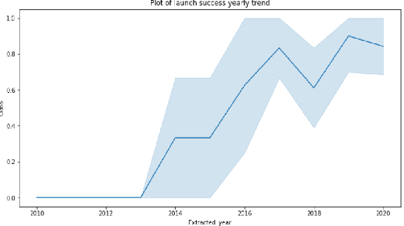
Launch Success Yearly Trend
from the plot we observe success since 2013 to 2020

Slide 24
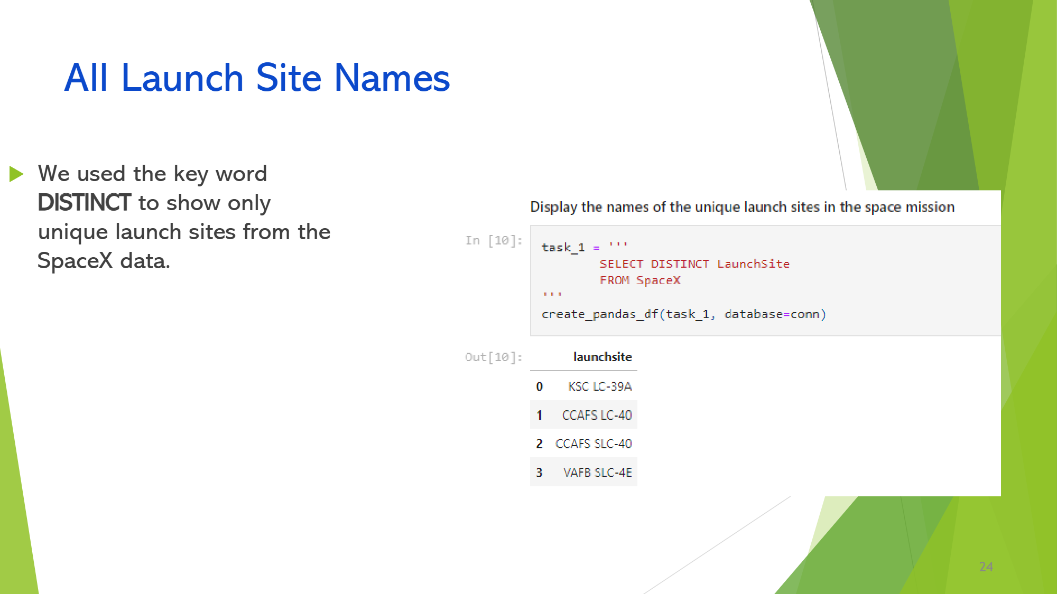
All Launch Site Names
Find the names of the unique launch sites
Present your query result with a short explanation here

Slide 25
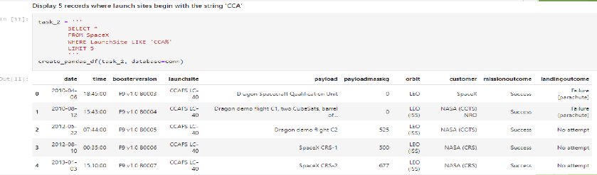
Launch Site Names Begin with 'CCA'
Query displays 5 records where launch sites begin with `CCA`

Slide 26
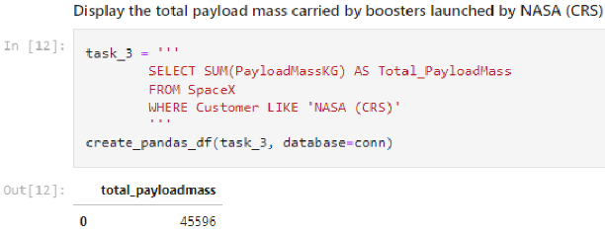
Total Payload Mass
Calculate the total payload carried by boosters from NASA

Slide 27
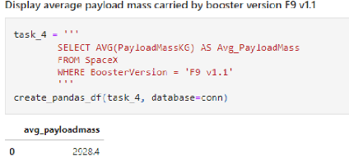
Average Payload Mass by F9 v1.1
Calculate the average payload mass carried by booster version F9 v1.1

Slide 28
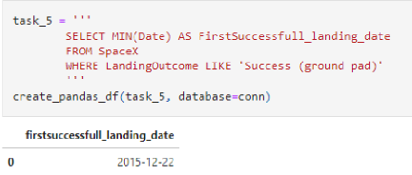
First Successful Ground Landing Date
Find the dates of the first successful landing outcome on ground pad Dec 22 2015

Slide 29
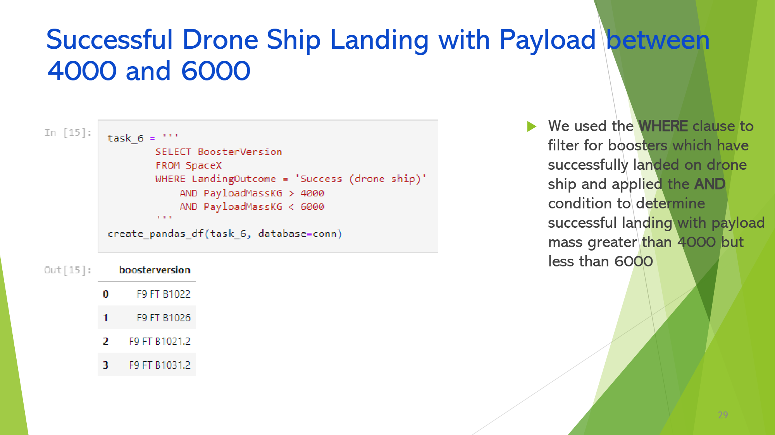
Successful Drone Ship Landing with Payload between 4000 and 6000
List the names of boosters which have successfully landed on drone ship and had payload mass greater than 4000 but less than 6000
Present your query result with a short explanation here

Slide 30
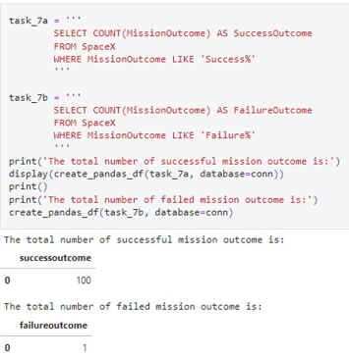
Total Number of Successful and Failure Mission Outcomes
Calculate the total number of successful and failure mission outcomes
use of where filter

Slide 31
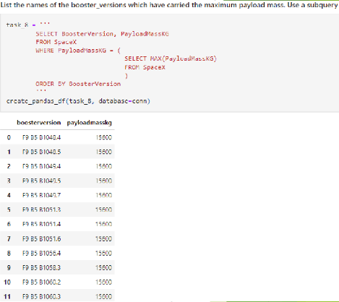
Boosters Carried Maximum Payload
List the names of the booster which have carried the maximum payload mass
we determined the booster that have caried max payload using subquery in WHERE clause and MAX() function

Slide 32
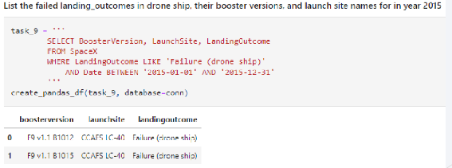
2015 Launch Records
List the failed landing_outcomes in drone ship, their booster versions, and launch site names for in year 2015
use of where, like, and, and between clause combos for 2015

Slide 33
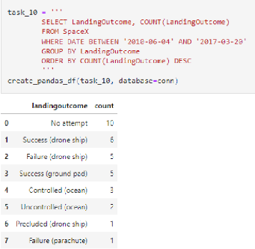
Rank Landing Outcomes Between 2010-06-04 and 2017-03-20
Rank the count of landing outcomes (such as Failure (drone ship) or Success (ground pad)) between the date 2010-06-04 and 2017-03-20, in descending order
selected landing outcomes COUNT, WHERE, BETWEEN clauses 2010-06-04 to 2010-03-20
groupby and orderby clauses

Slide 34

Section 3

Slide 35
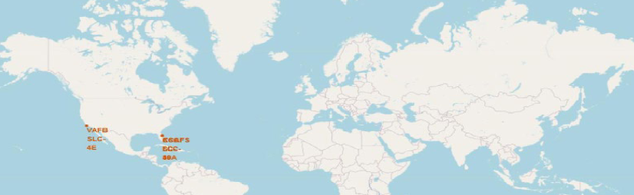
<Folium Map Screenshot 1>
we can see spacex launch sites are in U.S. florida and california

Slide 36
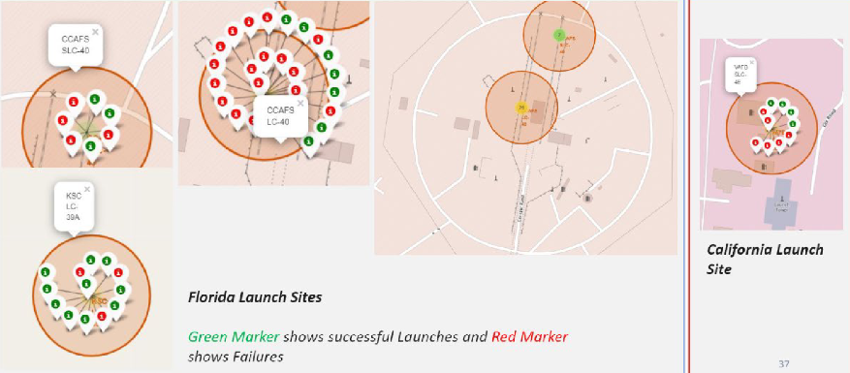
<launch site with color labels>

Slide 37
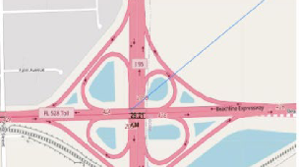
<launch site distance to landmarks>
Launch site

Slide 38

Section 4

Slide 39
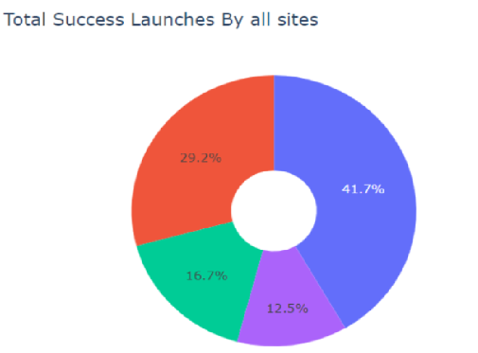
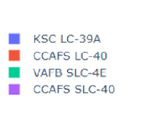
pie chart showing success percentage

Slide 40
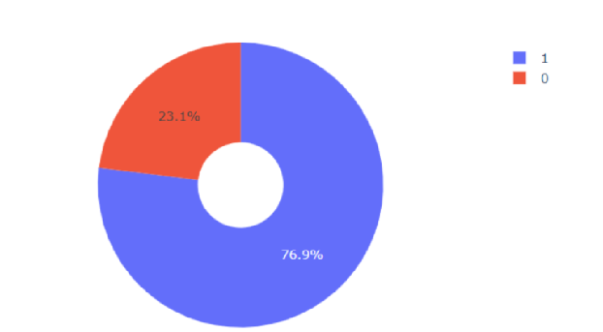
<pie chart showing launch site with highest launch site success ratio>

Slide 41
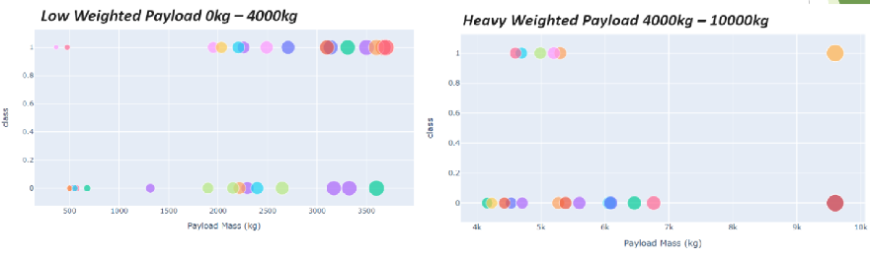
<scatterplot of payload vs launch outcome for sites>

Slide 42

Section 5

Slide 43
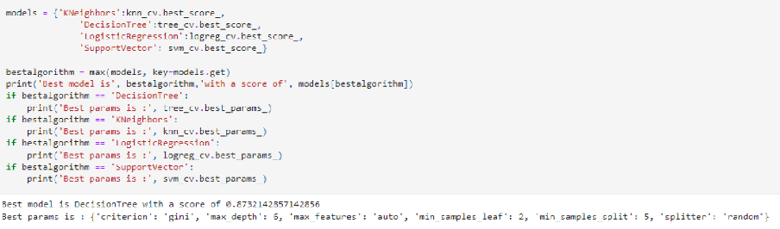
Classification Accuracy

Slide 44
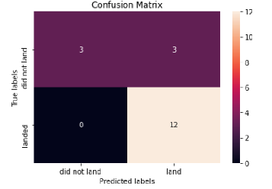
Confusion Matrix

Slide 45
Conclusions
larger flight amount at launch site = greater success rate at a launch site.
launch success rate started to increase in 2013 to 2020.
orbits ES-L1, GEO, SSO, VLEO had most success rate.
KSC LC-39A had most successful launches out of other sites.
Decision tree classified is algorithm for task.

Slide 46


